Slide 1


Slide 2



Organizers
Platinum Sponsor

Slide 3

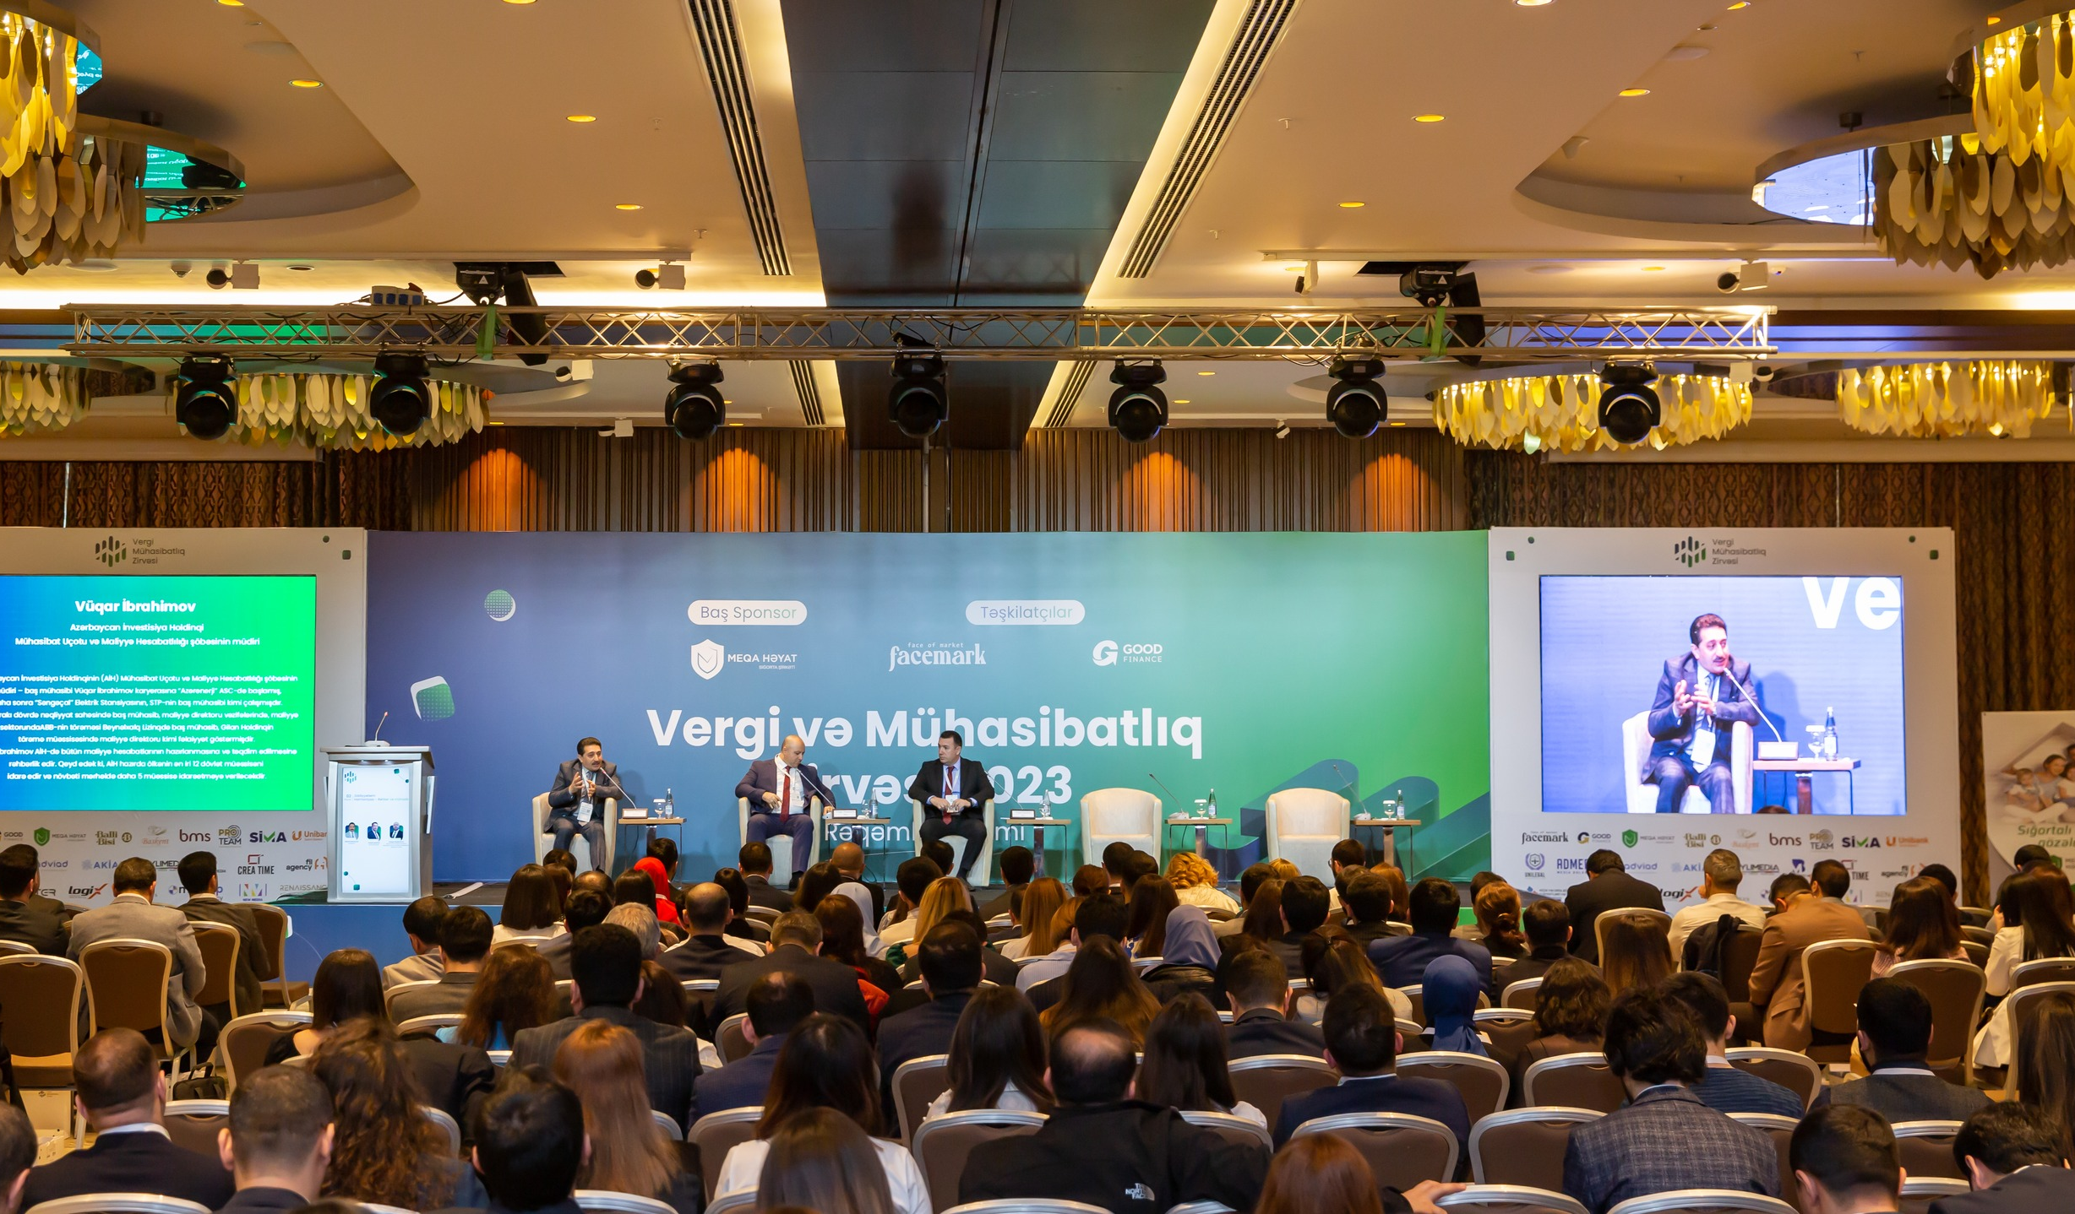
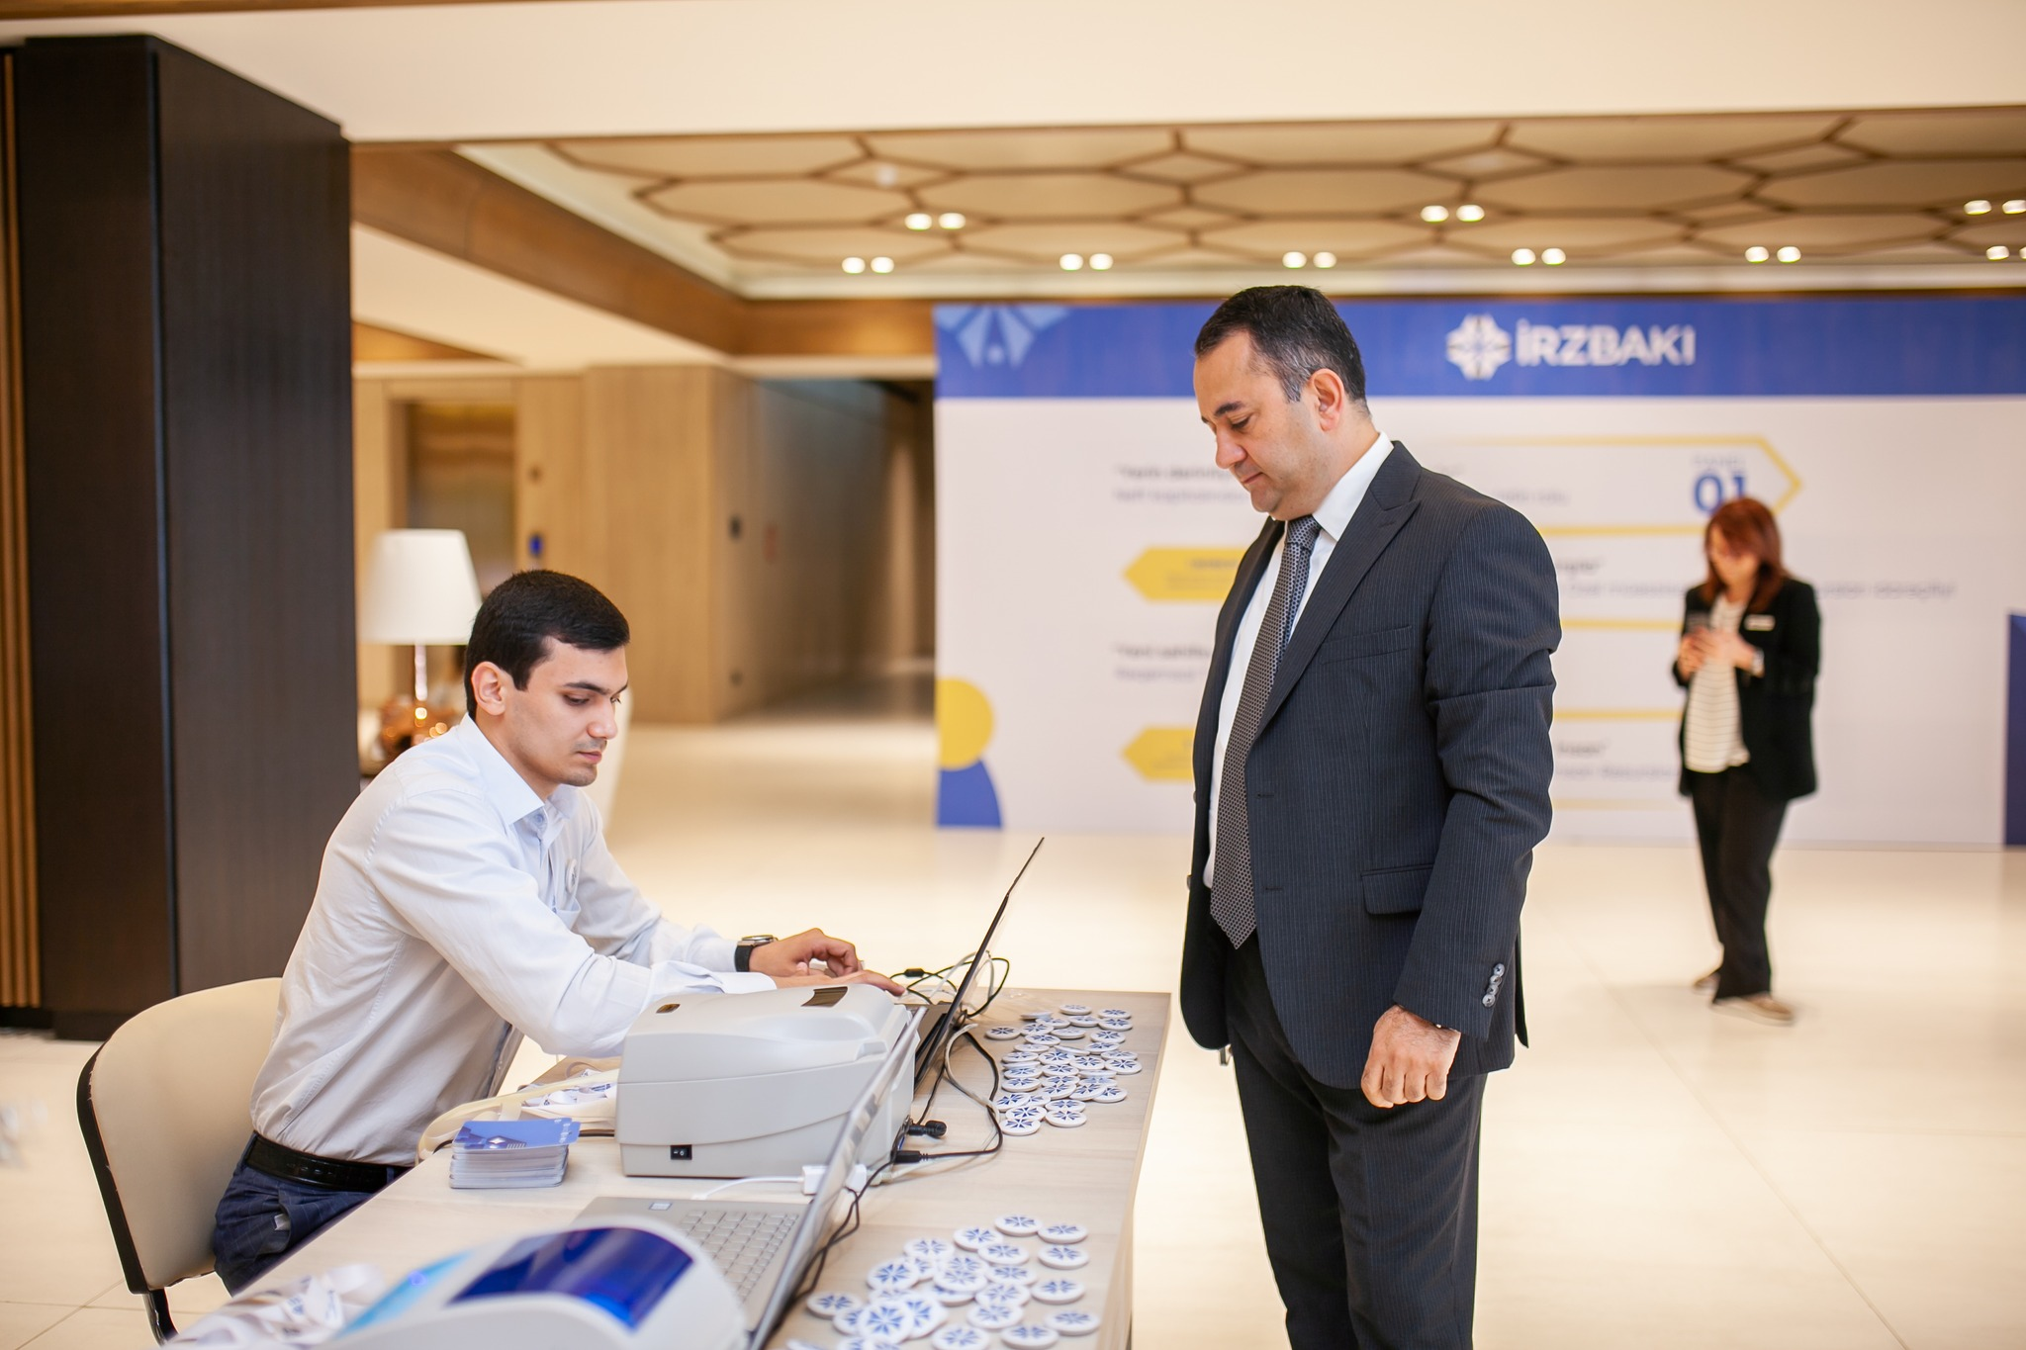
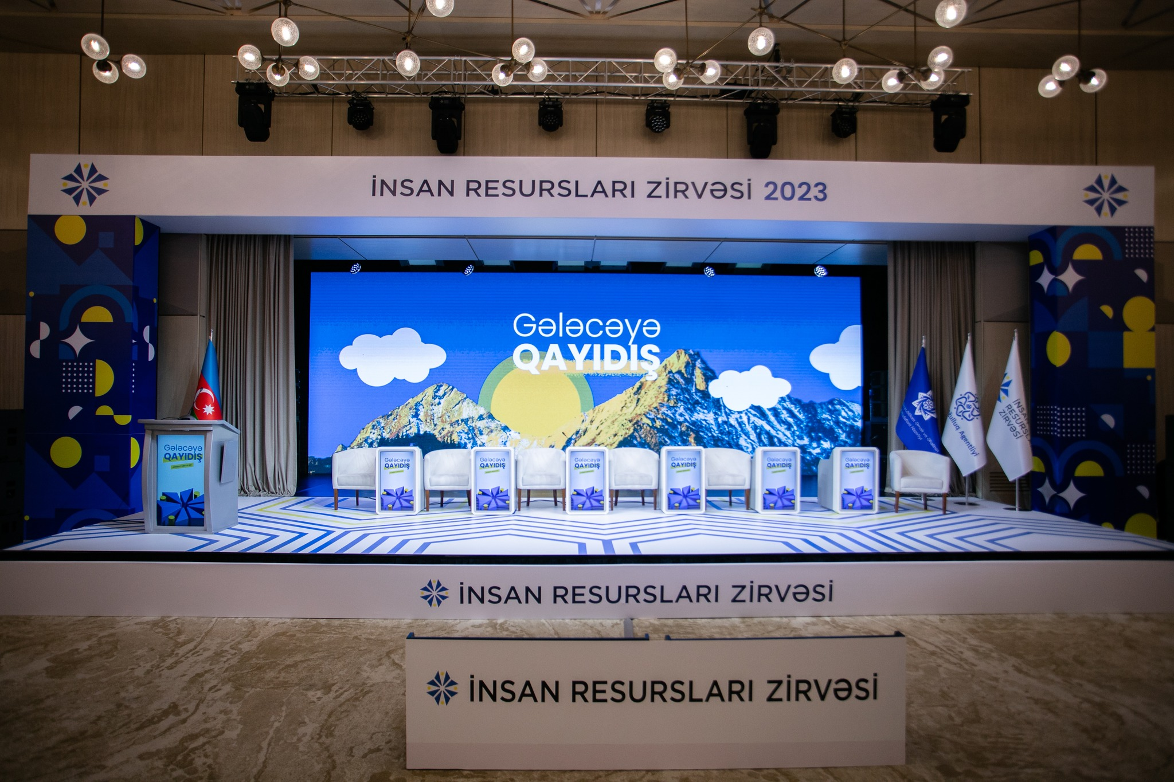
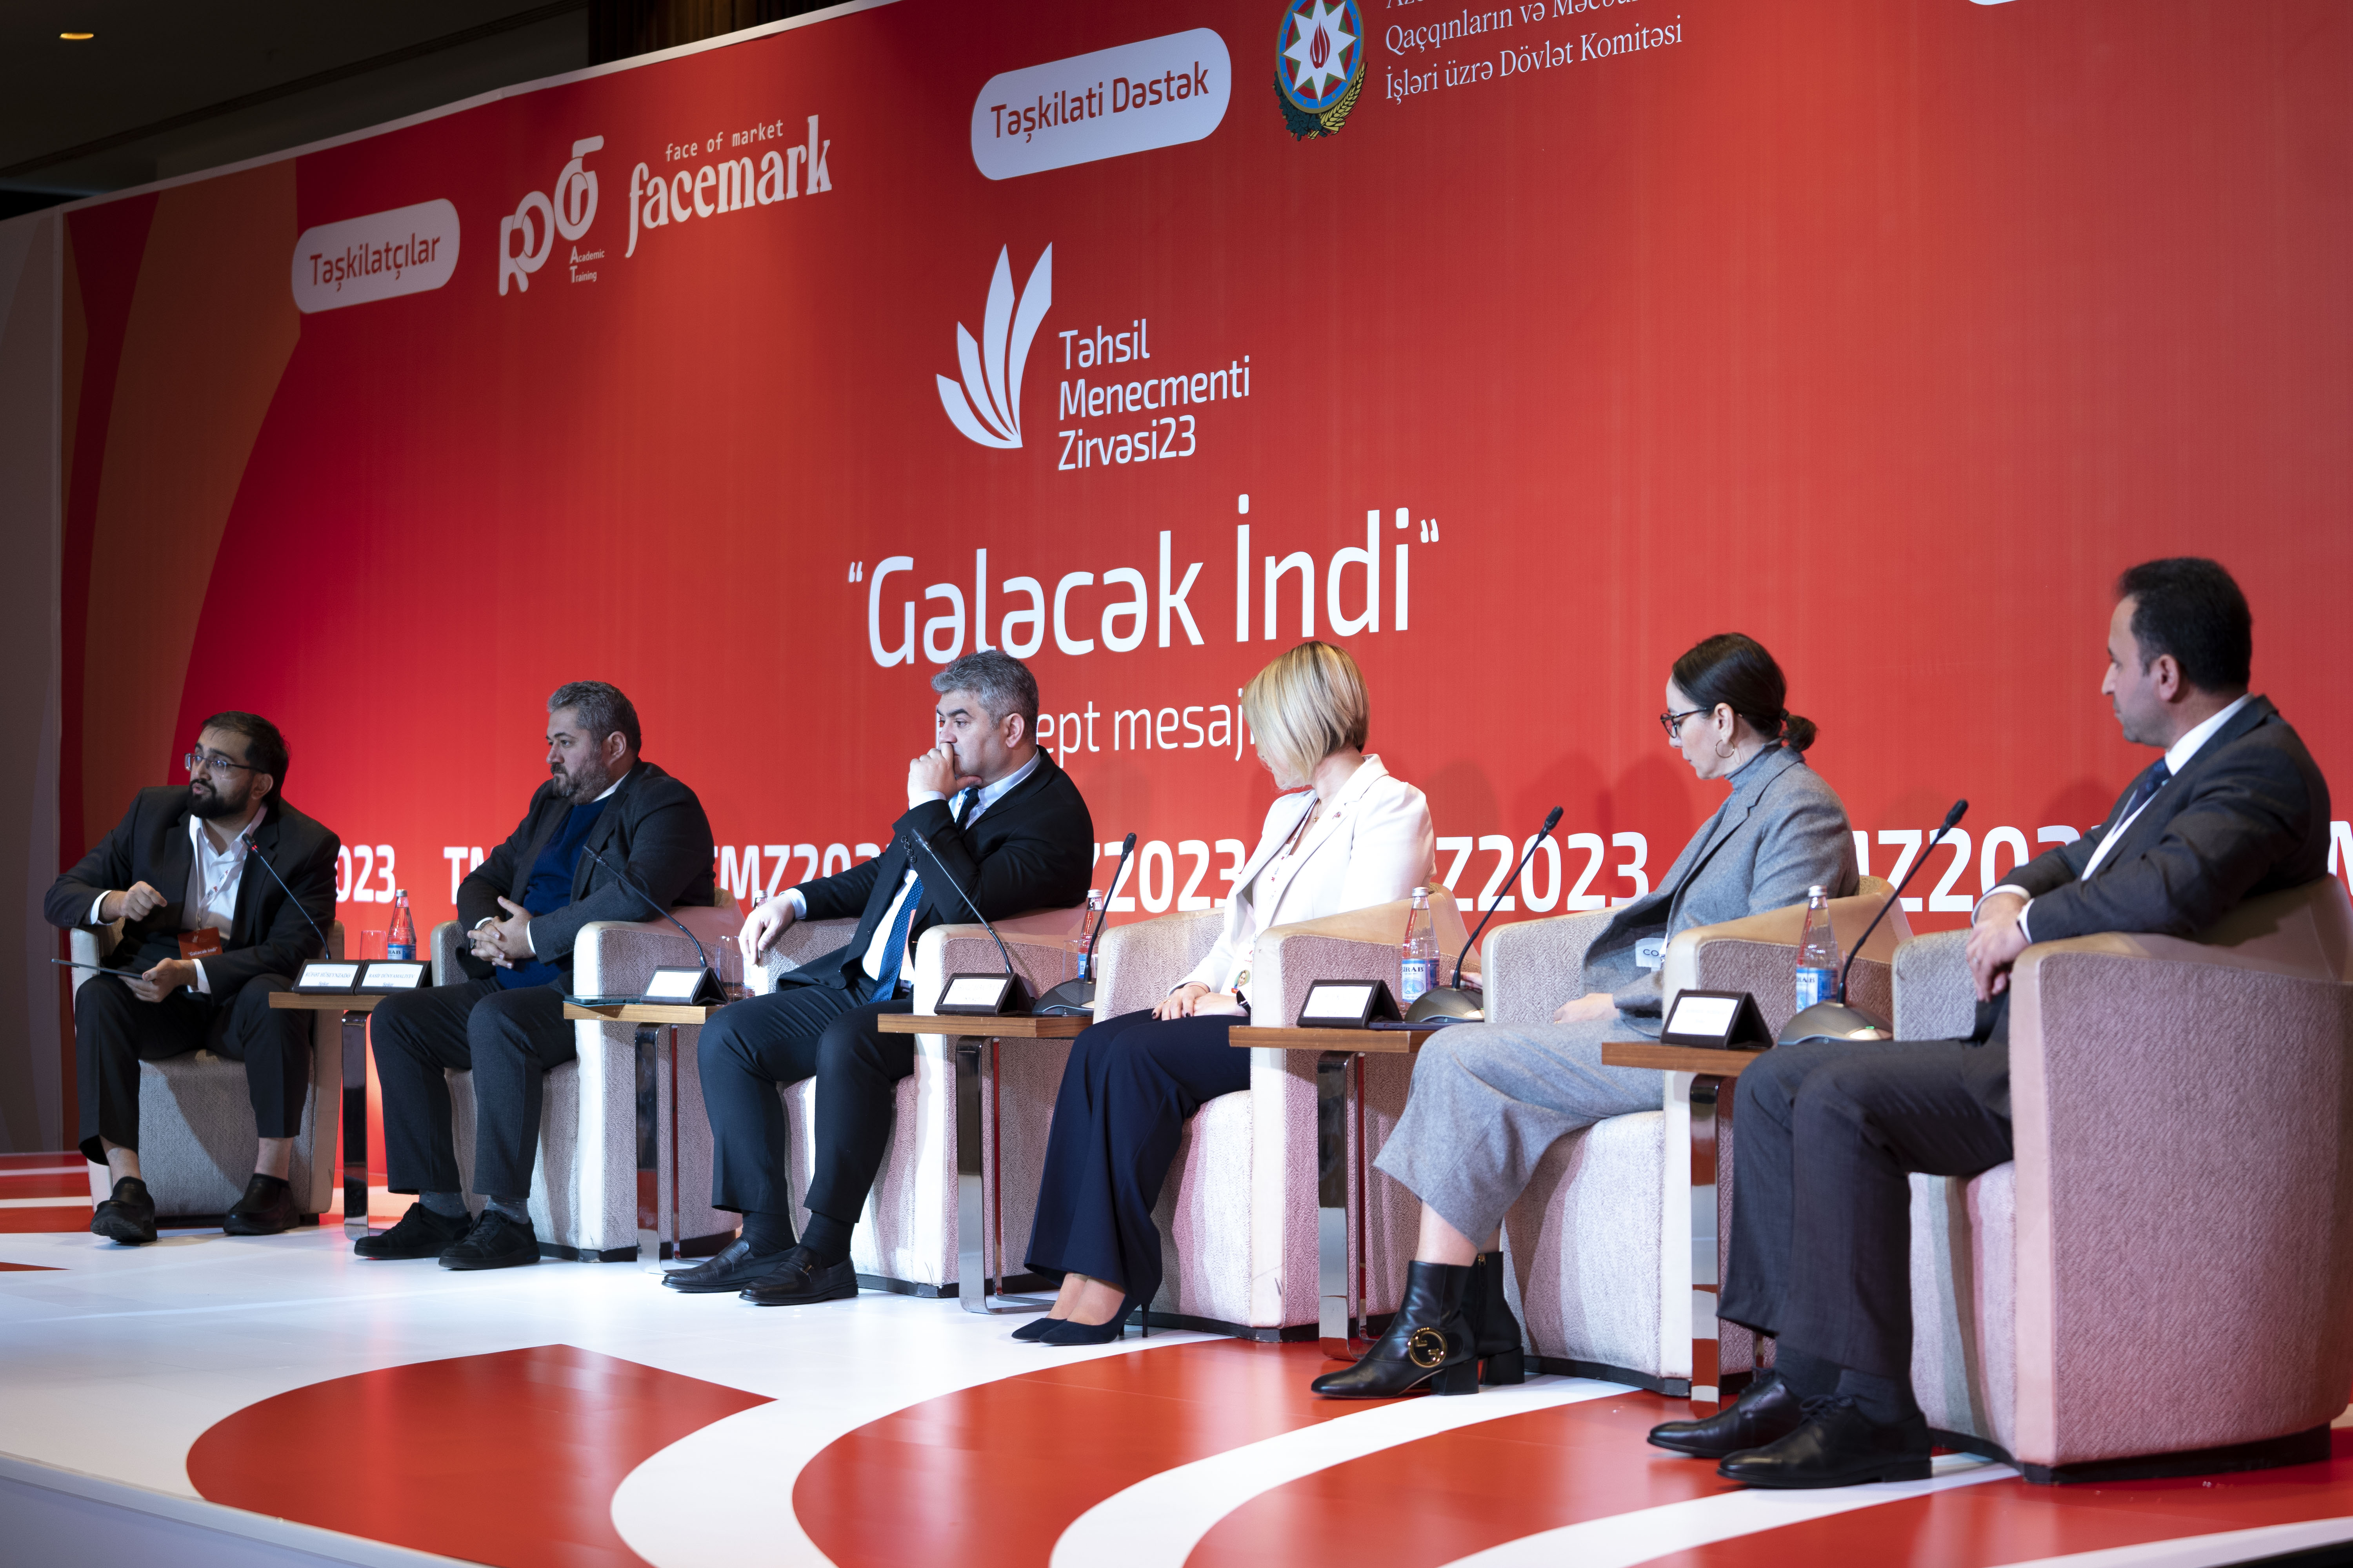
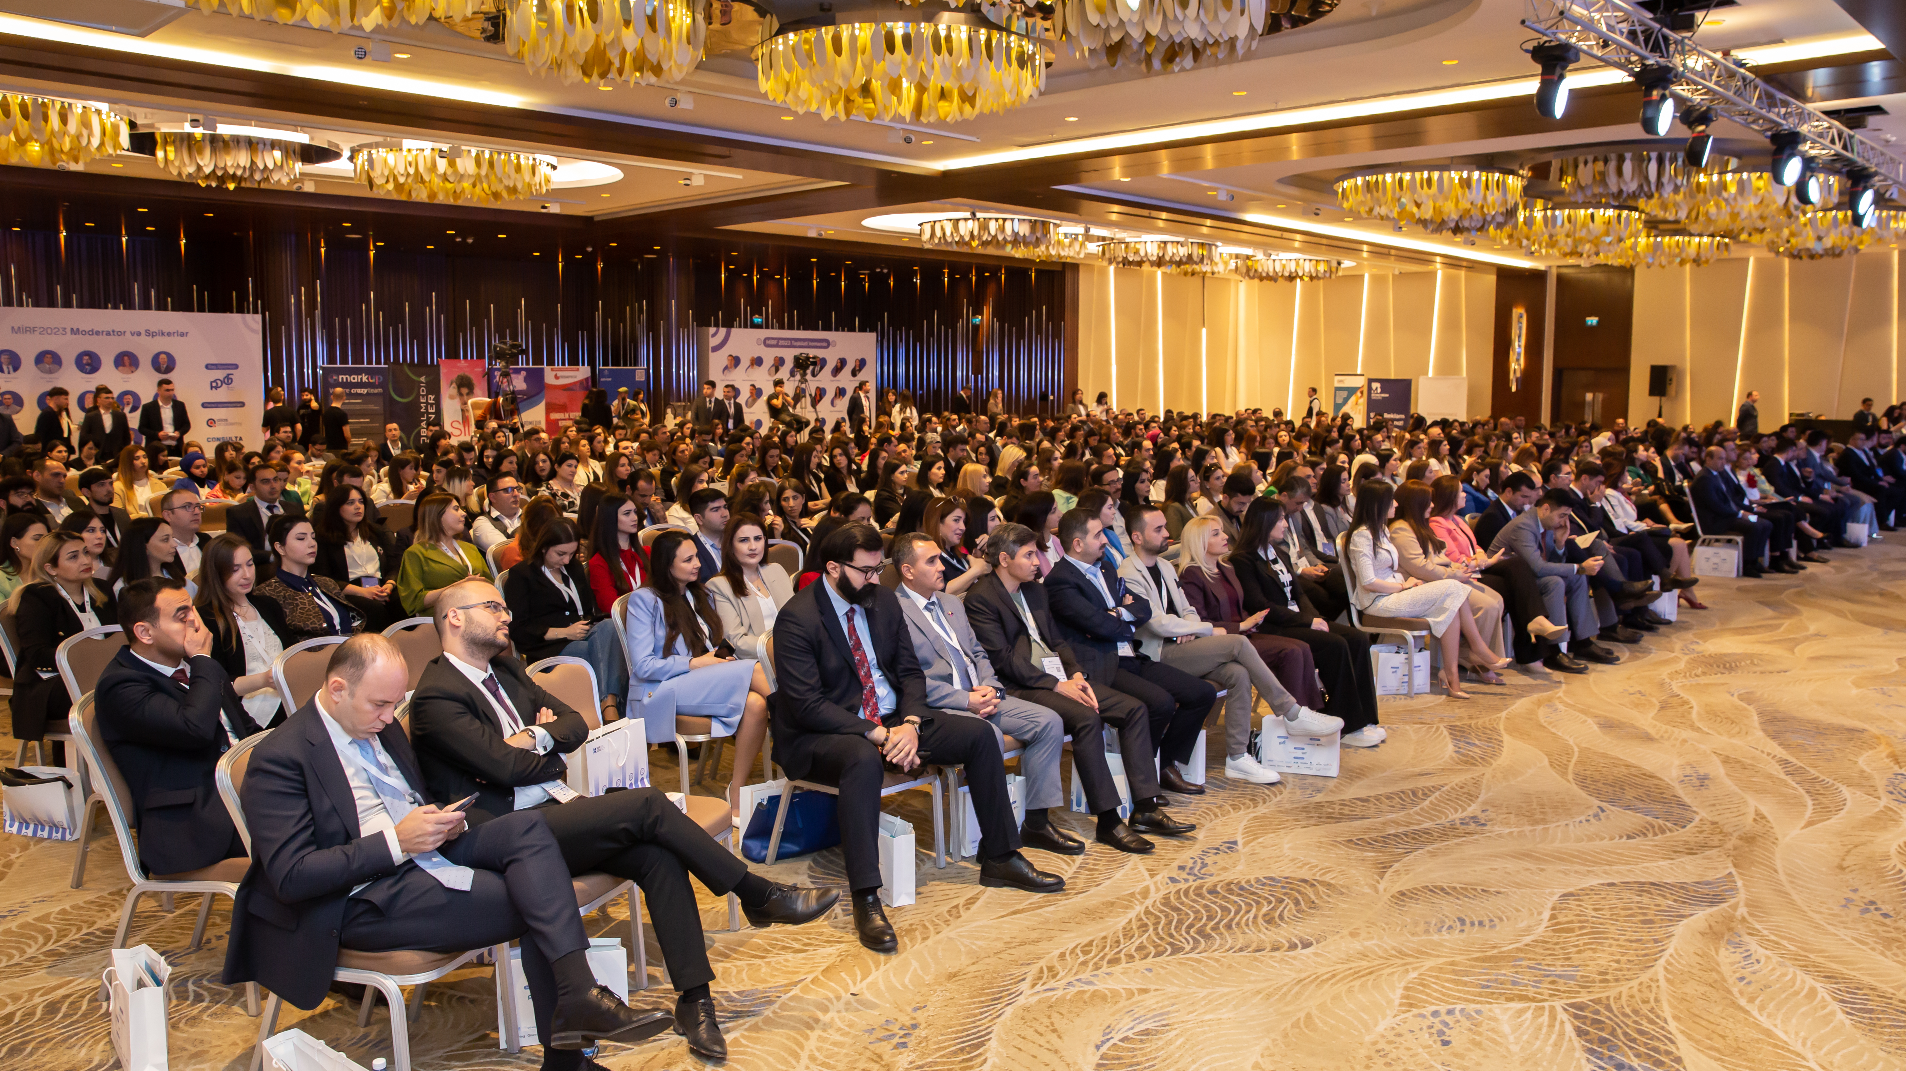
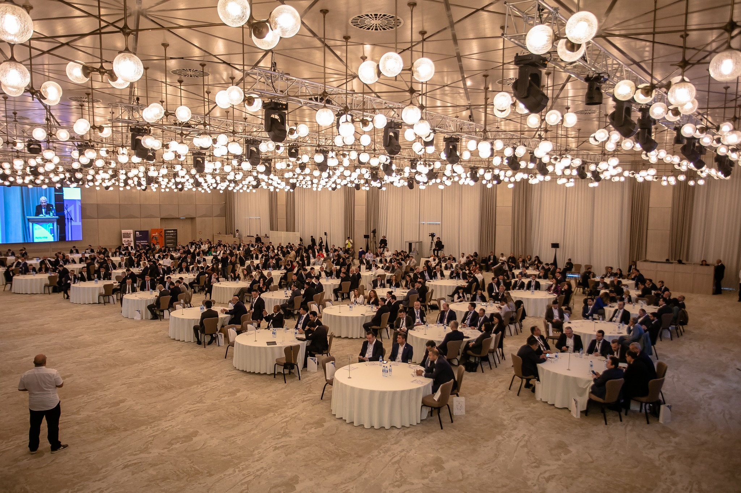
Links to events we organize
Human Resource Summit
www.dmcbaku.az
Tax and Accounting Summit
www.fifbaku.az
Digital Marketing Conference
www.mirf.az
Finance and İnvestment Forum
www.millimarketinqforumu.az
National Human Resouce Forum
www.unecforum.az
National Marketing Forum
www.wifbaku.az
İnternational Scientific Forum of Economics and management Researches
www.vmz.az
www.conferences.az
UNEC Economic Forum
Water Innovation Forum
www.irzbaku.az
Healthcare Management Summit
www.hmsbaku.az
Education Development Forum
www.tif.az
Industrial Management Summit
www.tmz.az
Education Management Summit
www.stz.az

Slide 4
Short videos from our forums and conferences
MİRF2023 https://kec.az/HwIgM
FIFBAKU 2022 https://kec.az/ZXUDu
MMF2022 https://kec.az/QsudK
UNEC2022 https://kec.az/HQSrA
WIFBAKU2022 https://kec.az/CgxHE
ISCEMR2022 https://kec.az/tuCKP
DMC2023 https://kec.az/pQjgJ
VMZ2023 https://kec.az/yUoCF
İRZBAKI2023 https://kec.az/pvwKO
TİFBAKU2023 https://kec.az/ylNuE
SMZBAKU2023 https://kec.az/POeLX
TMZBAKU2023 https://kec.az/VOzQa
STZBAKU2023 https://kec.az/jXoDo
Qısa İcmallar Playlisti: https://kec.az/AuOdU

Slide 5

About the Event
300 professionals together in the field of interior and furniture in Azerbaijan for the FIRST TIME!
IF FORUM 2024 serves as a platform for interior designers and furniture manufacturers in Azerbaijan. Architects, interior designers, furniture manufacturers working in our country, entrepreneurs engaged in the sale of home decoration products and foreign companies working in this field will be the main participants of the IF Forum.
On May 8, 2024, the forum plans to bring together about 600 participants and about 200 companies, covering one whole day.

Slide 6
Purpose of the Forum
IM Forum appeals to the expansion of the application of advanced examples in the field of world interior design and furniture in the Azerbaijani market. The Forum brings together professionals for the interior design profession to reach a higher level and for the development of professional furniture production in our country.
The main objective of IMF 2024 is to exchange ideas by discussing and analyzing the speeches of professional speakers in the field of design and their experiences in the field.

Slide 7

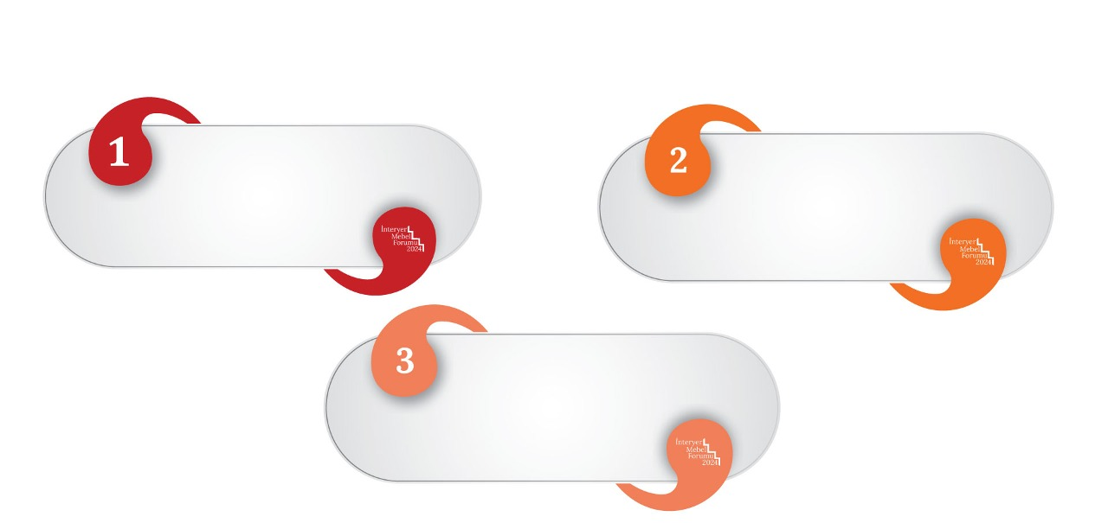
TOPİCS
Panel 1. A New Look at the Interior
Panel 2. How
Should Modern
Furniture Be?
Panel 2. Secrets of
the Design
Profession

Slide 8
Panel I
A New Look at the Interior
A professional look at interior design.
Constantly changing trends - Latest design concepts and analysis of all information flows together.
Discussion of all ideas in a single case for the formation of the interior design concept in an actual and most modern style.

Slide 9
Panel II
How Should Modern Furniture Be?
Furniture is the most important component in the interior.
Development of interior furniture production.
Discussions about changes in the field of furniture opening new paws in interior design.

Slide 10
Panel III
Secrets of the Design Profession
Everything from A to Z
Success in the field of design, various secrets and creative magic.
Discussion and analysis of all necessary steps to "professional activity".

Slide 11
BENEFITS OF PARTICIPATING IN THE EVENT

Slide 12
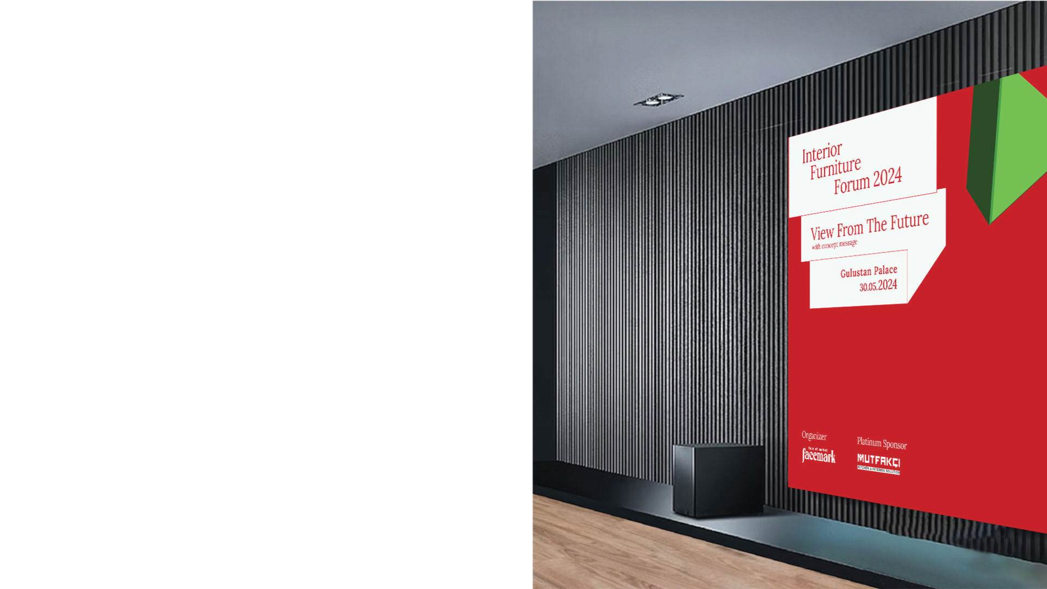
BENEFITS OF PARTICIPATING IN THE EVENT
The forum will allow to efficiently and effectively organize the activities of businesses operating in a hyper-competitive environment in the world, as well as state institutions, and to define our point of view in this direction.;
Participation in the organization of mutual discussion between state enterprises, supervisory bodies and business entities in the country and the opportunity to receive answers to open questions;
The opportunity to learn the innovations of the sector directly from the most well-known and professional experts of the sector, get presentations, reports, statistical data and direct communication about the sector;
Consultants operating in this sphere, persons engaged in academic and pedagogical activities;
After the event, the opportunity to obtain a short summary booklet of the main points discussed during the general day in electronic and printed form.

Slide 13
MAIN TARGET AUDIENCE OF THE EVENT

Slide 14

Main Target Audience of the Event
Azerbaijan's architecture, design and furniture manufacturing companies and decision-makers and opinion leaders;
Architects, interior designers, furniture manufacturers working in our country, entrepreneurs engaged in the sale of home decoration products;
Top managers, heads of departments of famous local and foreign companies operating in Azerbaijan;
Consultants operating in this sphere, persons engaged in academic and pedagogical activities;
Those who are interested in this field and want to get acquainted with the general concepts of the sector

Slide 15
GENERAL FORMAT OF THE EVENT

Slide 16
General format of the event
The forum with live presentations of foreign and Azerbaijani architects and designers will be held in the Davos format - discussion panels;
3 panels, 2 coffee-tea breaks and a lunch break are planned for one day.
The event will be held from 09:00 to 18:00 as a whole day in the form of an opening speech by representatives of state institutions, speeches by speakers from private and state companies, and panel discussions.
Questions to the speakers at the forum will be possible only by scanning the QR code on the agenda presented to the participants with a special QR code.
Full-day live recording of the forum, live broadcasting for online viewers, as well as preparation of photo and video summaries are planned.
The event will be open to the press and accredited media representatives from the official website.

Slide 17
Key topics to be addressed at the event
Panel 1: A New View of the Interior
1. Innovative Usage Techniques
2. Sustainable Interior Design Practices
3. Integration of Smart Home Technology
4. Multifunctional Furniture Solutions
5. Trends in Color Palettes and Textures
6. Creating Ambiance with Lighting Design
7. Cultural influences on interior spaces
Panel 2: How Should Modern Furniture Be?
1. Materials Innovation: From Sustainable Resources to High-Tech Fabrics
2. Minimalism vs. Maximalism: Finding Balance in Design
3. Accessibility in Furniture Design
4. Blend of traditional craftsmanship with modern aesthetics
Panel 3: Secrets of the Design Profession
1. Collaborative Design Processes: Insights from Industry Experts
2. Balancing customer expectations with design
3. The role of psychology in interior design
4. Ethical Considerations in Design Practice
5. The Future of Design Education and Professional Development

Slide 18
Interior Furniture Forum 2024 PR and Promotional Activity Directions

Slide 19
Event PR and Promotional Activity Directions
Posts (+ sponsored posts) on the forum's social media accounts for 3-4 months. Total number of 120+ posts
Outdoor advertising in the city - 6 video monitors for 2 months
Participation in radio programs - 3-4 times in 2 different radio programs
Participation in TV programs - participation in at least 2 TV programs, representation in the news program on the day of the event
A series of posts in the "Business Azerbaijan" Facebook group with 28,000 company employees
Publishing more than 20 materials on the Facemark.az business portal before the event
Publication of a series of press releases and interviews on TOP10 news and business websites - at least 4 times, a total of 25+ press releases
Preparation and broadcasting of programs on our Internet TV
Placement of web banners on news and business sites
Advertising on monitors in business and shopping centers
Live broadcasts with speakers before and after the forum (fmr tv)
2.000.000
TOTAL REACH

Slide 20
EXHIBITION / STAND PACKAGE
2500 AZN
Table for exhibiting products and services - 1 piece
Rollup placement - 1 piece
Placing a video monitor around the exhibition table - 1 unit (the video monitor must be provided by the customer)
Employee - 2 people to inform participants about products and services

Slide 21
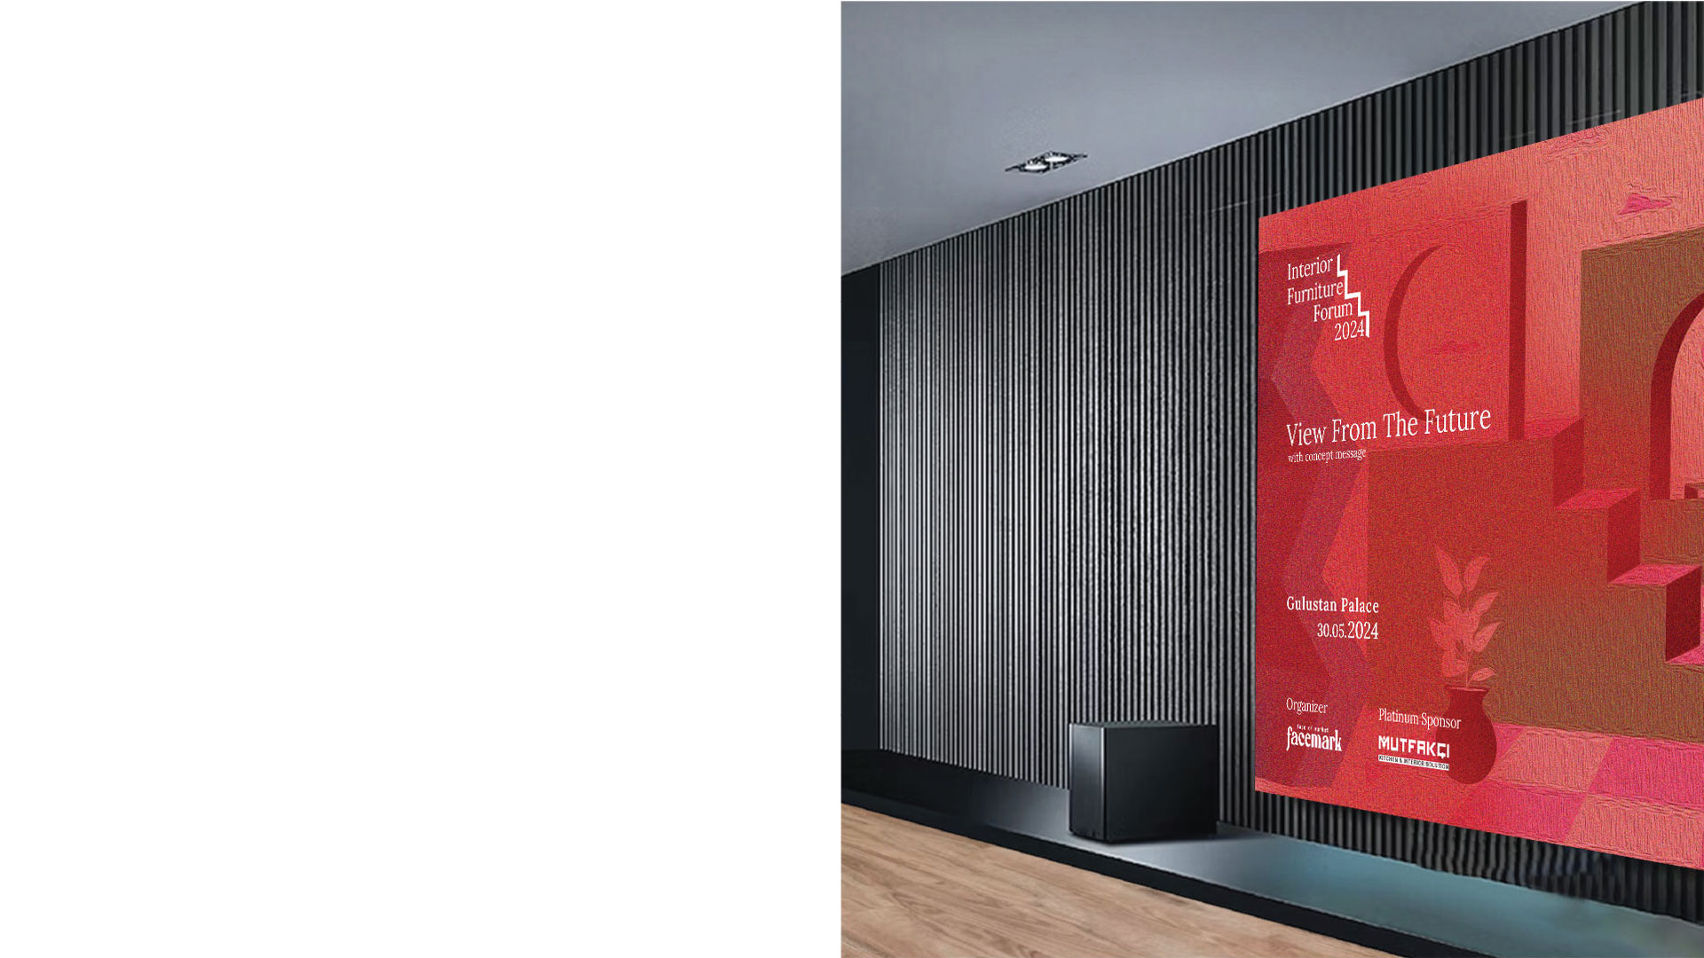
Contact
For sponsorship
Phone: 050 216 16 36
For more information and ticket sales
Phone: 050 216 16 36
Social Media account links
Facebook: https://www.facebook.com/profile.php?id=61556082195755
Instagram: https://www.instagram.com/imforumbaku/
Linkedin: https://www.linkedin.com/company/i%CC%87nteryer-mebel-forumu-i%CC%87mforum-2024/
Website: https://www.imforum.az/

